Slide 1


Embedded Systems Workshop
Session
8

Slide 2



Hello!
Instructor:
Fatma Ahmed
Abdelwadoud Ahmed
Cairo University, EECE Department.

Slide 3


connection Linkedin
Fatma Ahmed
Abd elwadoud

Slide 4


Content
Digital Signals
Analog Singal
PWM
ADC

Slide 5


Digital

Slide 6

Signals
Most modern devices nowadays work internally and communicate using signals
A signal can contain data or information to the other end, and it can either be digital or analog
Digital signals are mostly represented by binary format using 0s and 1s
1 = high (V5) = ON | 0 = low (V0) = OFF

Slide 7
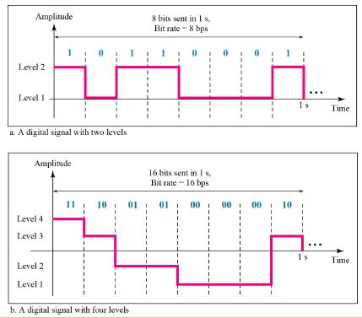
Digital Signals
A computerized device works with digital signals
A digital signal sequence works by converting information into bits
A bit is like a toggle, resulting 2 possibilities, true or false
By grouping bits together, we get bigger range of possibilities

Slide 8
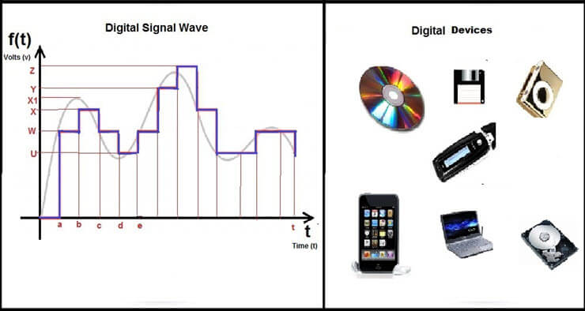
Example

Slide 9
Analog

Slide 10
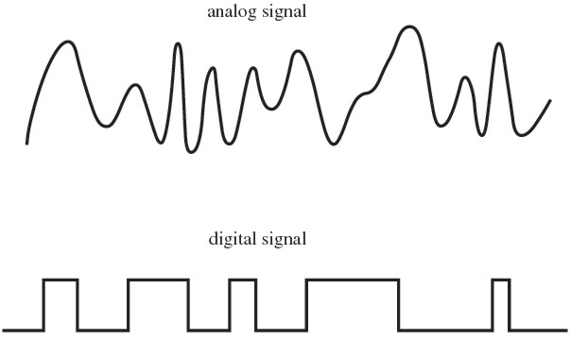
What is Analog?
Analog refers to any signal or value that changes continuously over time. It is not made of fixed numbers and does not change in sudden jumps; instead, it varies smoothly.

Slide 11
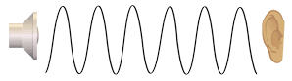
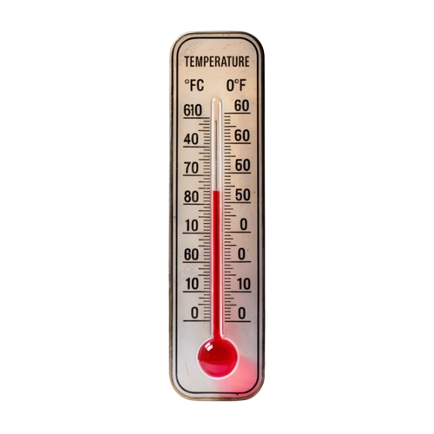
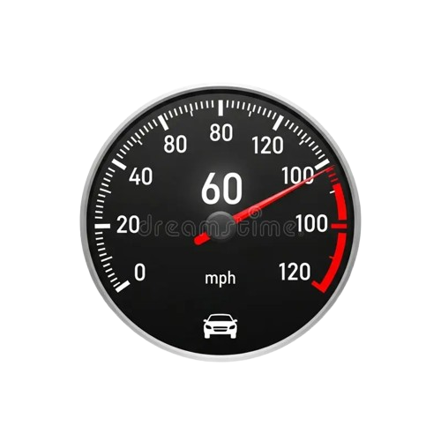
Real Life Analog in Our Daily Life
Sound, temperature, light, pressure, and speed are all analog quantities.
They do not jump from 0 to 1. Instead, they change smoothly and gradually over time.

Slide 12
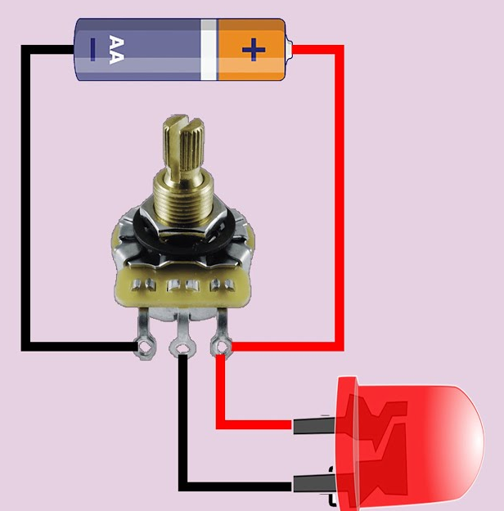
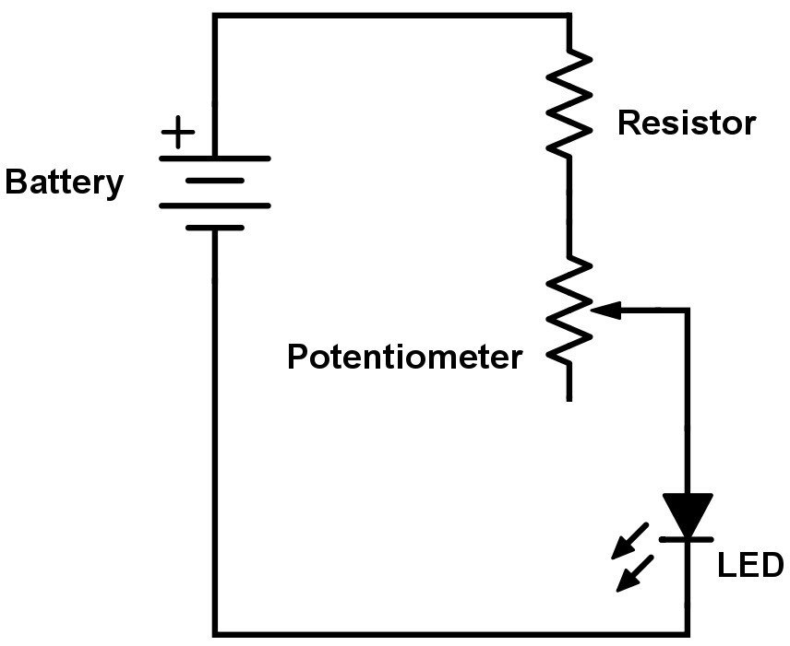
Analog in Electronics
Sensors produce analog signals.
Motors require smooth control.
Power delivery is also analog, allowing gradual changes rather than abrupt steps.

Slide 13
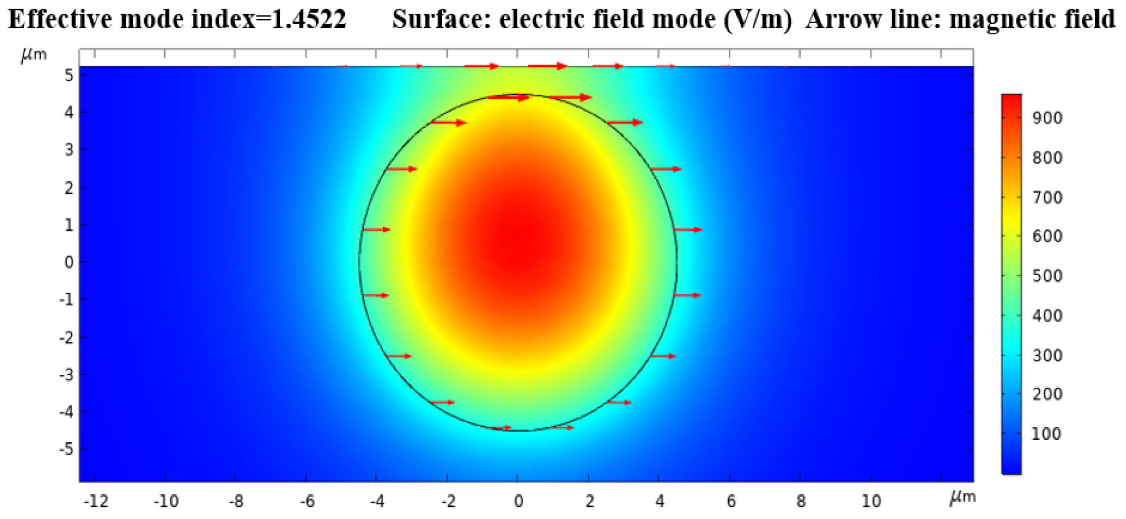
Why Do We Use Analog
We need smooth control.
We read real values, not just ON/OFF decisions.
This allows us to control speed, intensity, and force precisely.

Slide 14
Example
Feature | Analog | Digital
Value | Infinite possibilities | Limited steps (0 and 1)
Representation | A smooth curve (Sine wave) | A blocky "square" wave
Noise | Very sensitive (static on a radio) | Very resistant (it's either a 1 or it isn't)
Examples | Human voice, Mercury thermometer | Text messages, CD players

Slide 15
PWM

Slide 17
ADC

Slide 18
The Core Problem
A microcontroller is a digital device. It understands only two logic levels:
0 (LOW)
1 (HIGH)
The microcontroller cannot interpret these values directly.
ADC (Analog-to-Digital Converter)
ADC converts an analog voltage into a digital number.

Slide 19
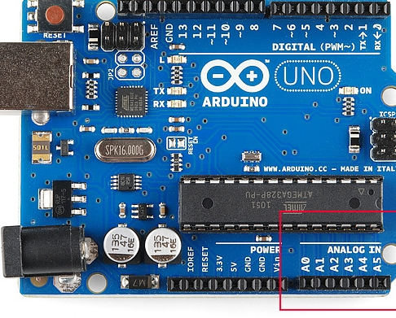
Analog Interfacing with Microcontrollers

Slide 20
What actually happens inside the Arduino?
The pin itself is not truly “analog.”
The analog pin:
It is a voltage input.
It receives a variable voltage, usually in the range 0V to 5V.
In the Arduino Uno, for example:
The microcontroller is ATmega328P.
Inside it, there is a built-in ADC (Analog-to-Digital Converter).

Slide 21
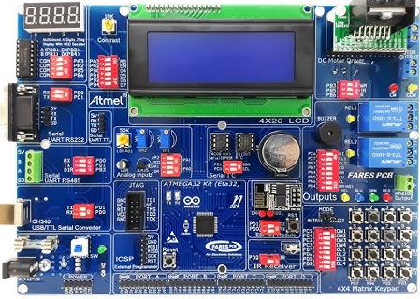

Slide 22
From Analog Input → to Digital Output
1.Analog Signal arrives at the pin
2. Analog Multiplexer (MUX)
The MUX selects which analog pin will be connected to the ADC.
When you call analogRead(A2), the MUX connects pin A2 to the ADC input.
3. Before conversion, the ADC must freeze the input voltage.
4. ADC measures the input voltage relative to Vref.
5. AVR uses a Successive Approximation Register (SAR) ADC.
Compares the input voltage with internal reference steps.
Approximates the closest digital value.
6. ADC Result Registers
7. CPU Processing

Slide 23
Session Task
Potentiometer controls LED brightness

Slide 24
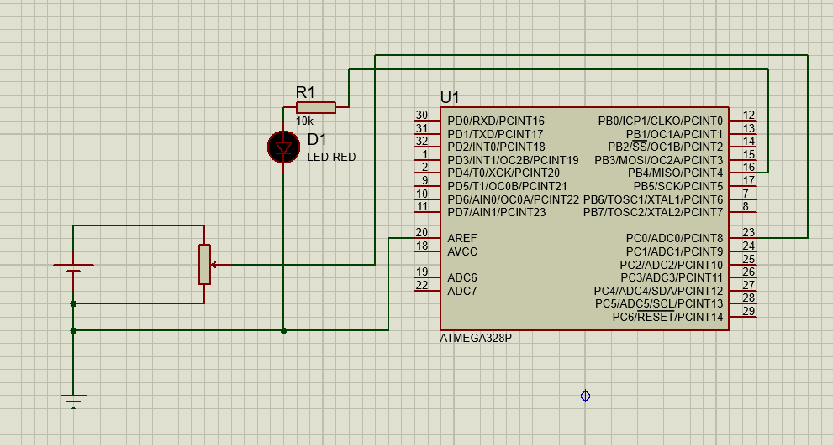

Slide 25
#define F_CPU 8000000UL
#include <avr/io.h>
void ADC_Init(){
ADMUX = (1 << REFS0);
ADCSRA = (1 << ADEN)
| (1 << ADPS2) | (1 << ADPS1);
}
uint16_t ADC_Read(){
ADCSRA |= (1 << ADSC);
while (ADCSRA & (1 << ADSC));
return ADC;
}
void PWM_Init(){
DDRD |= (1 << PD5);
TCCR1A = (1 << COM1A1) | (1 << WGM10);
TCCR1B = (1 << WGM12) | (1 << CS11);
int main(){
ADC_Init();
PWM_Init();
while (1)
{
uint16_t adc_value = ADC_Read();
OCR1A = adc_value / 4; }
}

Slide 26
Thank You!
Thank You!
Any questions?
Any questions?

Slide 27
Example
Example 1
Example 2

